Slide 1
ASE Hackathon Spring,15 Statistics Is Fun
By
The Marvel Hackathonists.
Srikar Reddy Mallareddygari (SM8XD)
Surekha Dani (SD3K3)
Lavanya Kumar Somu (LSXP7)
Sandesh Puppala (SPZC6)

Slide 2
Problem Statement
DST Use Case #1
John has a file that contains lots of numbers (all integer). They are unordered. He wants to generate some statistics around these numbers, namely COUNT, MEAN, Standard Deviation, MIN, MAX, and 25th, 50th, and 75th percentiles. The numbers are so large that it cannot be run on a single machine. Write a map-reduce program to generate above-mentioned statistics (no APACHE PIG, no HIVE). Technologies : Hadoop
System Requirements:
Technologies : Hadoop
Languages : Java
Virtual Machine : VMWare Player
Hadoop Image : IBM Infosphere Biginsights
Configuration Used:
RAM 16GB
1 TB Hard Disk
Operating System : Windows

Slide 3
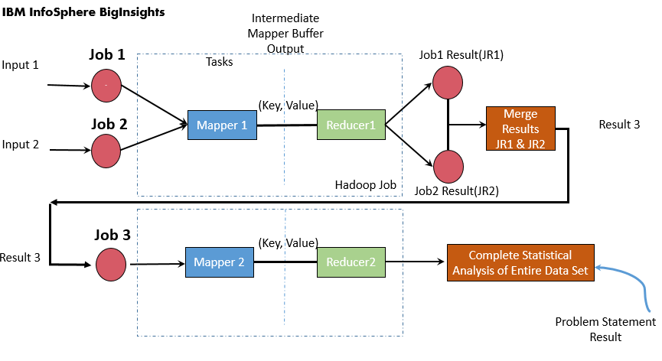
Architecture Diagram

Slide 4
Implementation:
In this program, we have three classes
Main Class (name of the class which having driver method i.e. main method)
Mapper class to Implement the Map side Business Logic
Reducer class to implement the Reducer side business Logic.
Approach for Programming the Map Reduce logic using Java:
Main / Driver Method
{
Invoke Mapper and Reducer Programs by map-reduce jobs.
Set No of Reducers = 2
Create 3 jobs - two of the jobs take individual input file and generate intermediate result by using set 1 of map-reduce program
Third job merges the output generated by the reducer output of above and performs final statistical analysis on entire dataset using set 2 of map-reduce program
}

Slide 5
Contd…
Set 1:
Mapper Class
{
Map Method
{
Read the Input data from the file and generate key value pairs
}
}
Reducer Class
{
Reduce Method
{
Read key value pairs and perform the partial business computations.
}
}

Slide 6
Contd..
SET 2:
Mapper Class
{
Map Method
{
Read the Input merged data file generated by reducers of set 1 and generate key value pairs
}
}
Reducer Class
{
Reduce Method
{
Read key value pairs and perform the complete business computations.
}
}

Slide 7
Input Dataset
Input Data set is two set of text document with the Integer dataset.
Input1: Input2:
15 5
20 25
35 20
50 50
40 45

Slide 8
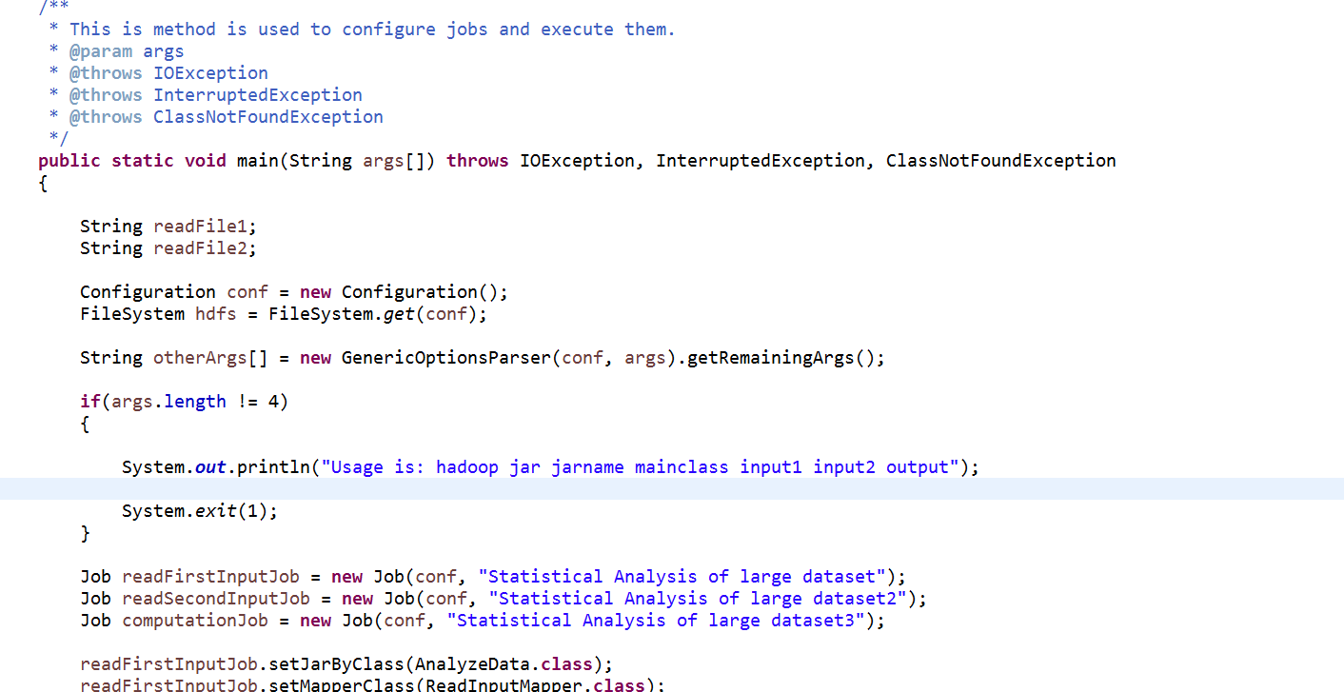
Driver Class

Slide 9
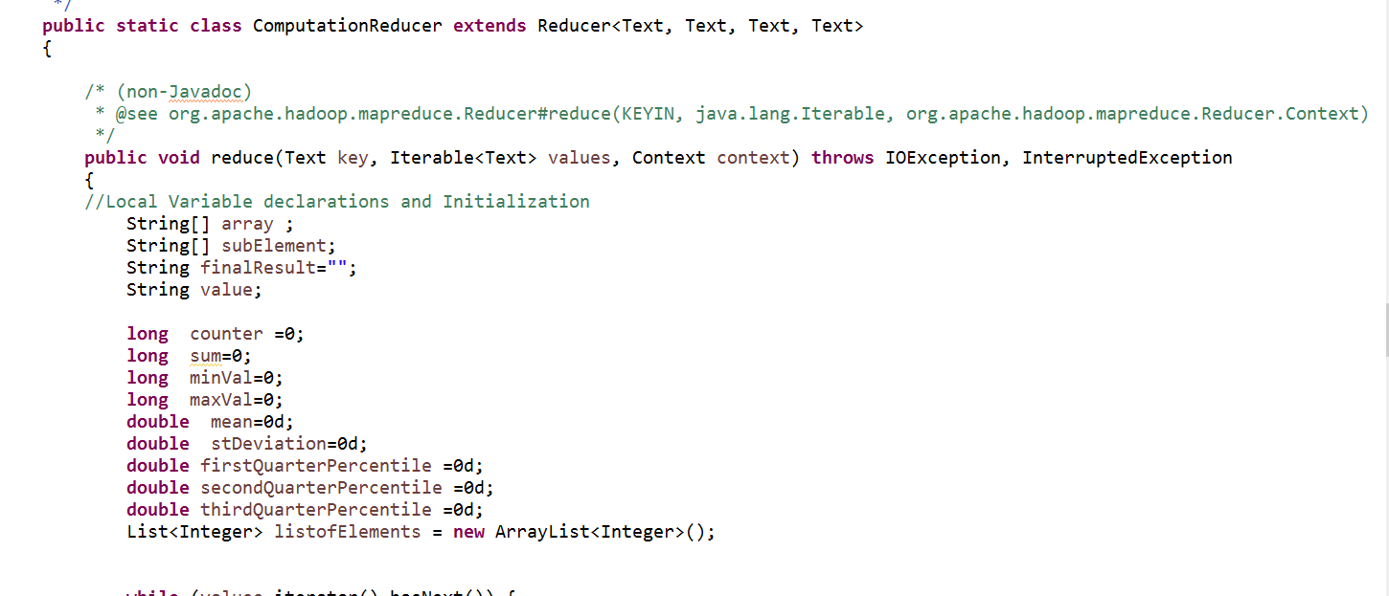
Job 3 Mapper Class

Slide 10
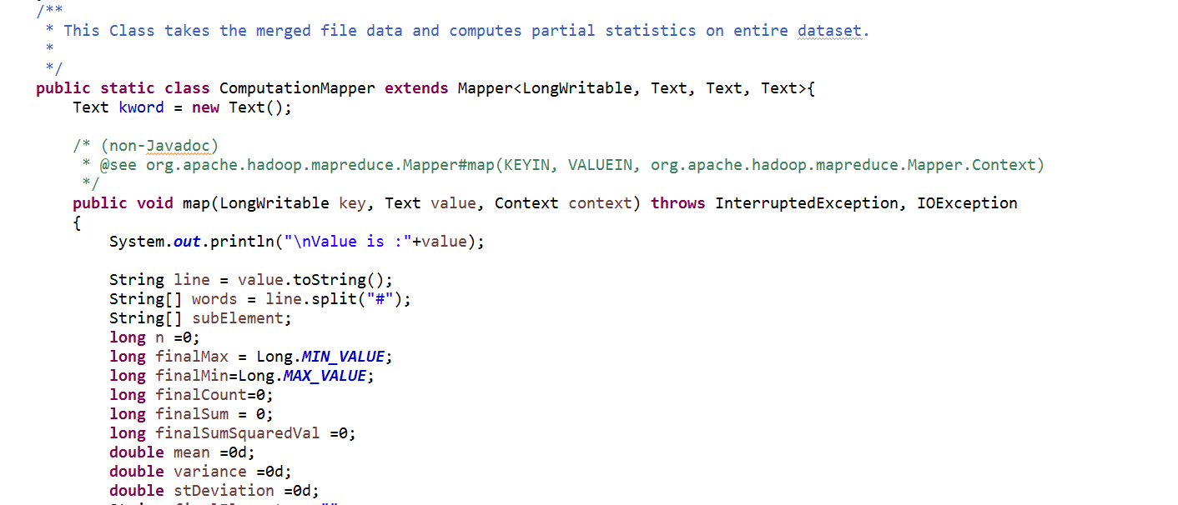
Job 3 Reducer Class

Slide 11
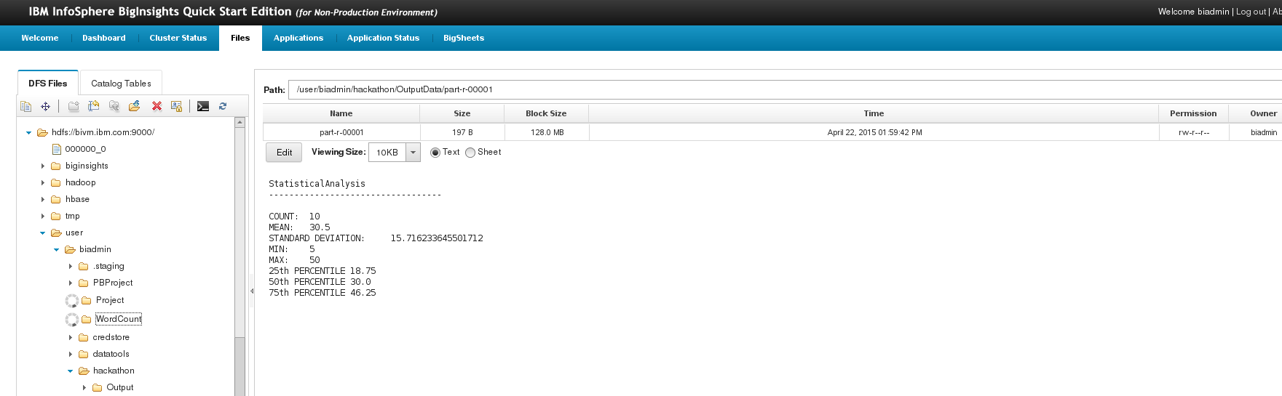
Output:

Slide 12
Hadoop Commands
create the directory in HDFS:
cmd> hadoop fs -mkdir /hackathon
cmd> hadoop fs -copyFromLocal /home/biadmin/Desktop/HackathonSP2015/input.txt /user/biadmin/hackathon/
cmd> hadoop fs -ls /user/biadmin/hackathon/
To Run the Map Reduce Program Jar file in Hadoop:
cmd> hadoop jar StatisticalAnalysis.jar com.hackathon.mapreduce.AnalyzeData

Slide 13
GitHub URL:
https://github.com/srikarreddy-m/CS551-ASE/tree/src/HackBattleSP15
YouTube URL:
https://youtu.be/Tbf8TwPv5u0

